Slide 1
OpenCart
Persistent Interactive | Persistent University

Slide 2
Introduction
OpenCart is an online store management system. It is PHP-based, using a MySQL database and HTML components.
This application is an ideal opensource ecommerce solution for every business.
It is freely available under the GNU General Public License.
It is built with a purpose to boost online sales for any small or large business.
It provides various features like it is SEO(Search Engine Optimization) friendly, free to use, has
APIs enabled, fast and secure and provides outstanding support also it is very easy to use.

Slide 3

Software Specification
Eclipse IDE
Apache POI
TestNG
AutoIT

Slide 4
Manual Testing
The initial phase of our project was writing down the manual test cases for all the modules. In order to accomplish that we used excel format that is used by most of the testers.
Then classified written test cases into Automatable and Non-automatable.

Slide 5
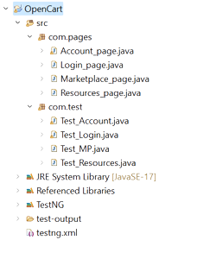
Project Object Model
Project Object Model is a design pattern in selenium.
Used to access large number of web elements efficiently.
Each page module has its individual page and test class. E.g. Account module has Account page & Test_Account classes.
Helped to reduce code duplication.

Slide 6
Apache POI
Apache POI is an open-source java library to create and manipulate various file formats based on Microsoft Office.
Using POI, we were able to perform create, modify and display/read operations on different file formats.
We have used Apache poi for reading the excel file for testing different types of input.

Slide 7
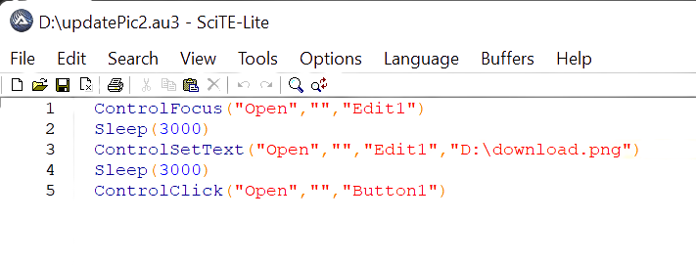
AutoIT
AutoIt is a freeware scripting language designed for automating windows GUI and general scripting.
Useful in uploading image files on the site.

Slide 8
TestNG
TestNG is a testing framework that makes selenium tests easier to understand and helps generating reports that are easy to understand.
TestNG consist of Suites which also helps in grouping test cases.

Slide 9
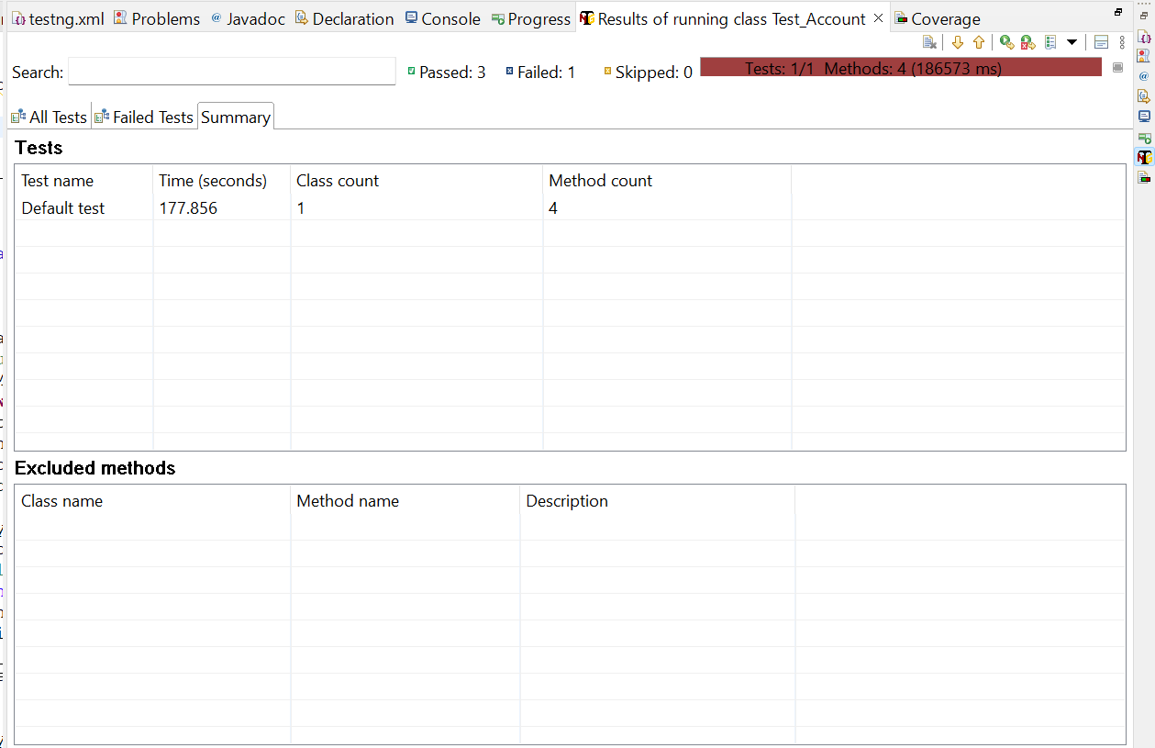
TestNG
TestNG summary for Test Account

Slide 10
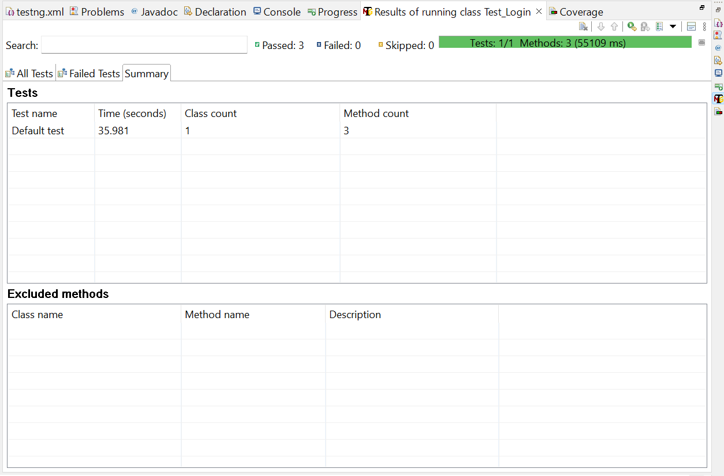
TestNG
TestNG summary for Test Login

Slide 11

TestNG
TestNG summary for Test Market Place

Slide 12

TestNG
TestNG summary for Test Resource

Slide 13
Work Distribution - Manual
Nikita : Test Plan Document, BRS
Nupur : Test Scenario, Test Case Document
Aditya : Requirements, Execution Log, Execution doc
Sarang : ECP, BVA
Harshada : Defect Report, State Transition

Slide 14

Automation
Shubham : Login Page
Sarika : Resources Page
Disha : Marketplace Page Module 1
Aishwarya : Marketplace Page Module 2
Pragati : Account Page
Integration
Sarang, Disha

Slide 15
Issues and respective learnings

Slide 16
Sr. no. | Name of Team Member | Issues Facing | Remedy | Issue Occured Date | Issue Resolved Date | Comments | Status
1 | Aishwarya | TestNG library setup installation in selenium IDE | Communicating with EIS Service Desk team to resolve the issue | 23/9/2022 | 24/9/2022 | Getting system generated errors while installing TestNG suite on eclipse luna | Resolved
2 | Disha | Firefox webdriver was not able to run through script for this website | Use Chrome Driver instead of Firefox Driver | 20/9/2022 | 20/9/2022 | Script failed when tried to run using gecko driver. Use chrome driver. | Resolved

Slide 17
Thank you!
Persistent Interactive | Persistent University

